Slide 1

Web Final Project
Thomas Dias Costa

Slide 2
Project objectives
Show diferents informations like : Temperature, humidity, polluants...
Print some graphics
Propose clear and accessible visualization

Slide 3
Tools Used
CSS Framework : Bootstrap
Weather API : Open Weather Map

Slide 4
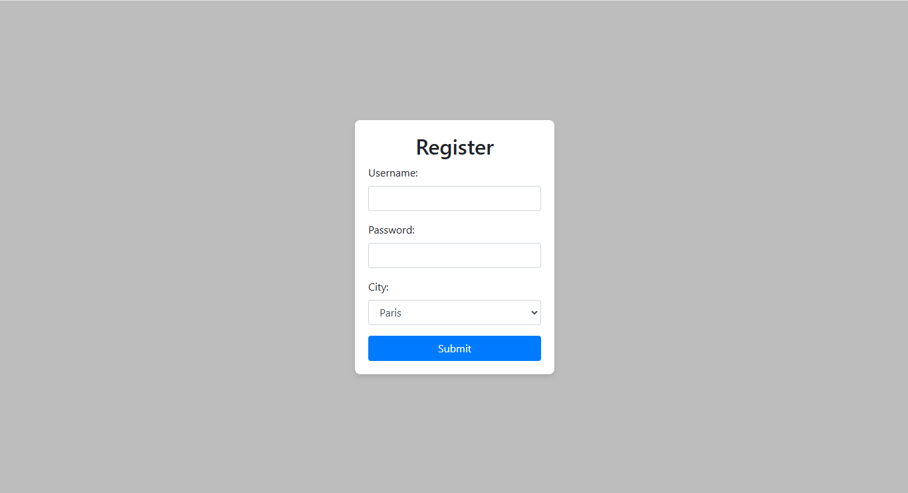
Register Page
Page where the user can register by giving their name, password and city

Slide 5
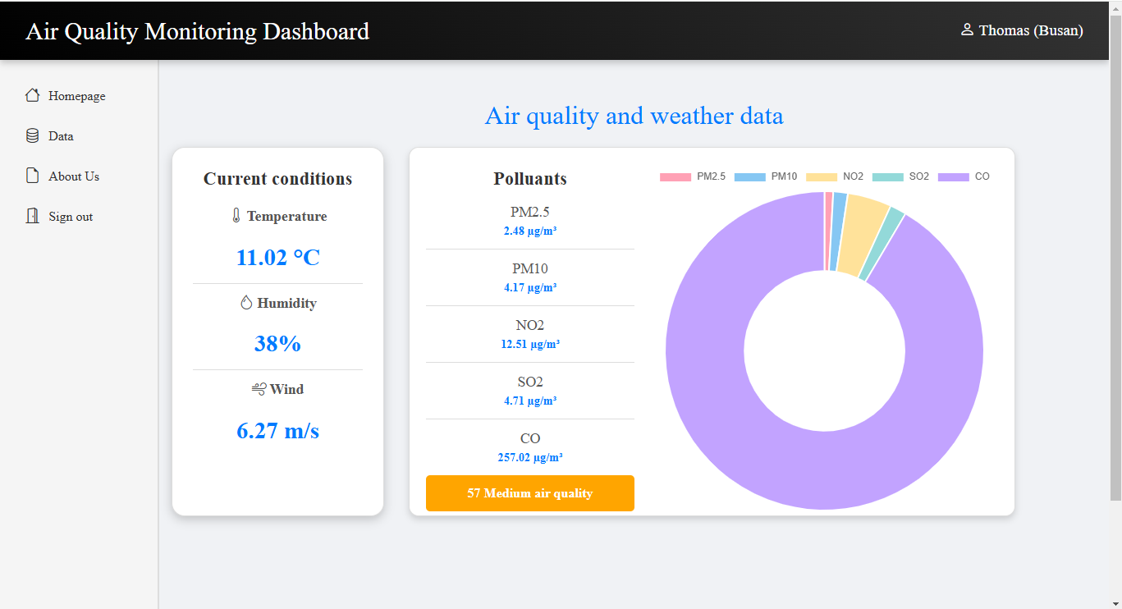
The Homepage
Main page where you can see several weather informations and where you can retrieve the name and the city entered by the user

Slide 6
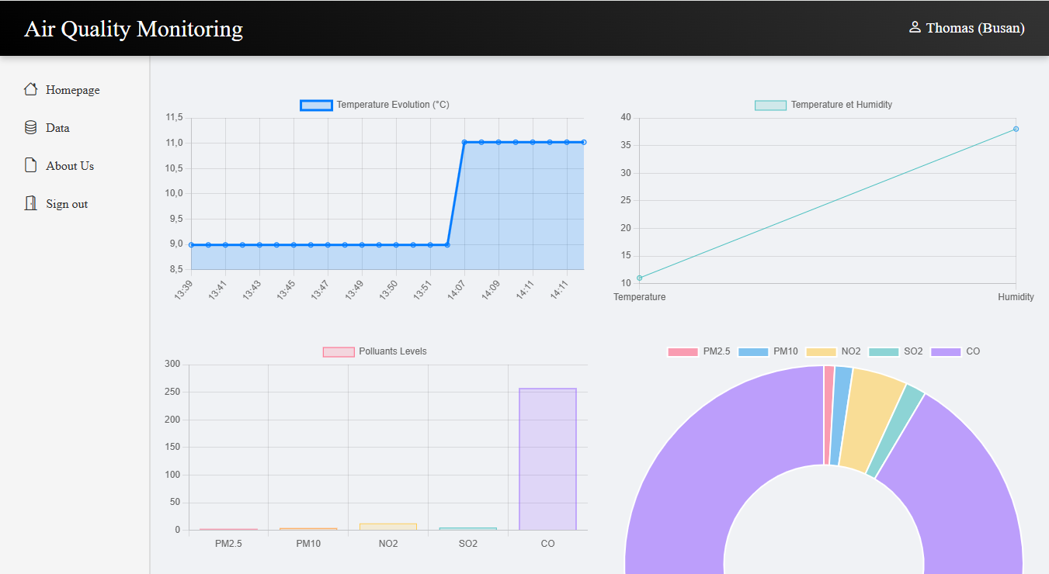
Data page
Page in which you can find more data and in particular the different graphs

Slide 7
Ameliorations
Visual improvement
Added the text bar to change the city without having to log out
Make a graph of humidity versus time
Retrieve more data from the API (weather forecast, old weather data, rain, etc.)

Slide 8
Website Presentation

